Slide 1
Building an Inclusive User Research Practice
IRS OFFICE OF ONLINE SERVICES
June 7, 2022
A Case Study in Progress
Alcora Walden, Brandon Szabo, Ronna ten Brink (Contractor)

Slide 2

What is the Inclusive Design Mindset?
Notes:
Image source: Microsoft PPT stock image

Slide 3
Putting Inclusive Design to work
Why conduct research with people from underrepresented populations?​
It supports building access in from the start​
It diversifies the participant sample​
It improves usability for all ​
Lean in to discover more about your audiences, test your assumptions, and expand beyond the known best practices.
“We can do more than just clear the path. ​We can lay out a welcome mat.”
- Lexie Kane, a UX designer specializing in research and data visualization

Slide 4
OLS Inclusive Design Strategy
The IRS Office of Online Services (OLS) Inclusive Design Strategy aims to build design capabilities and practices in OLS, such that the voices and needs of underrepresented taxpayer groups are included in the research and design process.

Slide 5
What Inclusive Research asks
How do we:
Identify underrepresented audiences?
Prioritize underrepresented groups for research inclusion?
Understand their journeys through IRS digital services?
Improve and prioritize existing services and experiences?
Conduct high-quality research with these groups?
Quantify the business value of these activities?

Slide 6
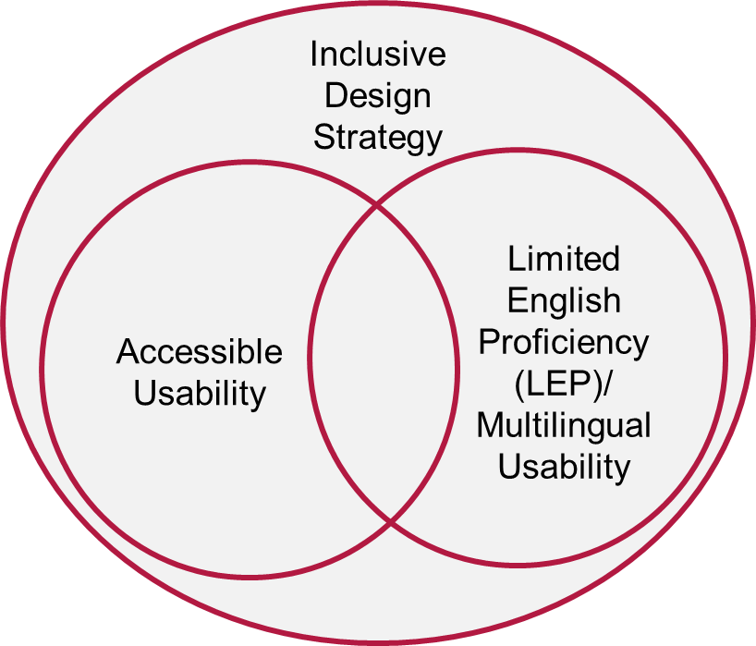
Making Inclusive Research work
We use the Inclusive Design Strategy to:
Identify digital services for usability research with populations​ of interest
Conduct user research ​with underrepresented groups
Monitor the participation rate of populations of interest in usability research ​
Provide expertise in accessibility, multilingual services and Inclusive Design​

Slide 7
Growing the Inclusive Design Capability

Slide 8
Our work so far
Gathered information about current state and needs within IRS
Piloted usability research with populations of interest
IRS.gov Usability Study with Limited English Proficiency Populations
IRS Homepage Usability Study Replication with Blind and Low Vision Participants
Taxpayers with Disabilities Survey
Shared knowledge both within IRS and externally through presentations, workshops, and guidance
Created the Inclusive Design maturity model and documented best practices

Slide 9
Research Pilot: IRS.gov Usability Study with LEP Populations
How well can LEP users find and navigate translated IRS.gov content in their preferred language?
METHOD
RECOMMENDATIONS
Unmoderated task-based testing with remote moderated interviews
10 Spanish-speaking participants
9 Mandarin Chinese-speaking participants
Tasks built around the IRS.gov translation toggles and links; translated Earned Income Tax Credit (EITC) pages; and translated Get Transcript pages
Support users finding translated content more easily
Ensure that all parts of common workflows are translated
Use plain language as much as possible
Make it easier for users to find important links
Use guided process features to help users complete multi-step processes
The best translations are useless if taxpayers can’t find them

Slide 10
Research Pilot: IRS.gov Study Replication with BLV Participants
How effectively does the IRS.gov homepage serve blind and low vision (BLV) taxpayers?
How should a “typical” OLS user study be modified to research effectively with BLV participants?
METHOD
RECOMMENDATIONS
Remote moderated task-based testing
Adapted from the IRS.gov Homepage Refresh Usability Study
5 BLV participants
Tasks built around finding information within the page
Investigate how elements that pose difficulties for BLV users can be made more accessible, or explore design alternatives that work well for all users
Research how removing repeated content might impact usability for a variety of users
Strive for maximal usability for assistive tech users
Continue improving usability and services for BLV users to maintain positive taxpayer perception
Taxpayers with disabilities notice and appreciate usability improvements

Slide 11
Research Pilot: Taxpayers with Disabilities Survey
How do taxpayers with disabilities file taxes?
What accessibility issues do they experience and what are their preferences?
METHOD
RECOMMENDATIONS
Remote moderated structured interviews
5 BLV participants
Questions about past tax-related experiences, current filing practices, and preferences and familiarity around select tax services
Ensure taxpayers can easily receive content in accessible formats
Support participants’ ability to independently communicate with the IRS
Raise awareness of available services
Continue improvements
Accessible formats are key to taxpayer independence

Slide 12
Research findings support future work
Lessons learned enabled us to create training materials, guidance resources, and maturity model
Lessons learned informed this year’s research, including:
Choosing what to research
Selecting research questions
Forming a team with needed skill sets
Planning method, tasks, and interview questions
Planning recruiting and logistics

Slide 13

The Inclusive Design Maturity Model
5. OPTIMIZING
Inclusive Design culture embedded in the UX practice
Organizational focus shifts to innovating for underrepresented populations
IRS shares and provides expertise to other agencies
5
4. QUANTITATIVELY MANAGED
Metrics to track inclusion in R&D are established and collected
Metrics are reviewed regularly
Lessons learned are actively captured
Improvement process is in place
4
3. DEFINED
Inclusive Design fully integrated into product dev process
Processes are defined and repeatable
Inclusive Design practices are used, but not consistently
3
2. MANAGED
Some Inclusive Design processes are documented
Growing awareness of Inclusive Design
2
1. INITIAL
Ad-hoc or reactive consideration of underrepresented users
No documented inclusive practice procedures
1
Maturity model inspired by Level Access’s Digital Accessibility Maturity Model (DAMM).

Slide 14
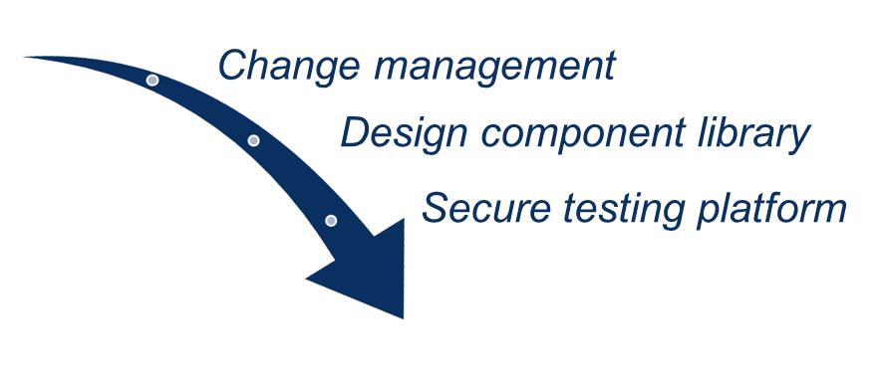
Organizational change management
Build an Inclusive Design practice by building a robust design culture within a scaled agile environment
Past development process
IT partners build out front-end prototypes based on what UXD has designed and tested using prototyping software.
Piloted development process
IT partners build out their front-end prototypes more iteratively, in tandem with design development, using IRS Online Design Guide components in a pre-production environment. Testing on pre-production designs is done using IRS Labs.
Key facilitators: Change management, design component library, secure testing platform

Slide 15
How we’re continuing
Usability research with populations of interest
On IRS’s Spanish-language voicebot with LEP Spanish-speaking participants
On findability and usability of IRS.gov’s translation toggle for LEP participants
On select online services with participants with mobility and/or cognitive disabilities
Expanding the Taxpayers with Disabilities Survey to participants with more types of disabilities
Creating usability testing best practices and materials for working with LEP participants
Sharing Inclusive Design knowledge and creating a community of interest

Slide 16
Actionable Tips for Effective Research with PWD and LEP Participants

Slide 17
Typical Usability Testing Timeline
2
Develop prototype
6
Recruit participants
4
Obtain necessary approvals
8
Analyze the data
5
Set up study environment
7
Conduct the test
3
Plan the study
9
Report results
1
Define research goals

Slide 18



Best Practices
2
Develop prototype
6
Recruit participants
4
Obtain necessary approvals
Translate prototype content
Cultural, language review
Design review (ex. number formats, form design)
Participant check-in
8
Analyze the data
Accessibility audit of all outreach materials
Additional recruitment cost
Specialized recruitment services
Group comparison, task completion, etc. considerations
Conduct accessibility audit for selected population(s)
Culturally-competent outreach & messaging
5
Set up study environment
7
Conduct the test
3
Plan the study
9
Report results
1
Define research goals
Bilingual notetaker
Translate study materials
English proficiency criteria
Tech-check sessions
Longer sessions with breaks
Accessibility audit setup
Document additional procedures for participant travel, meet and greet
Accessibility audit of consent, incentive delivery
Define and prioritize populations
Build research team with relevant skills
Pilot protocol and time to completion
Cultural, language review
Moderator training
Participants with disabilities
Limited English proficiency participants

Slide 19
Define Research Goals
Identify what the team and stakeholders want to learn from the research based on strategy, past research, and subject-matter experts. This is the foundation for how you will conduct the research, with whom, and what impact you hope to have.
Familiarize team with prior research
Meet with stakeholders
Define and document research goals
Build a research team with relevant skills
Points apply to research with both LEP and PWD unless noted otherwise.

Slide 20
Develop prototype
When developing the prototype or identifying the system you will test, it’s important to ensure it is usable, understandable, and culturally sensitive to your participants.
In order to maintain focus on the usability of a service, test or review prototypes to ensure they are accessible to the audience of interest.
PWD: Develop and test prototype or wireframes according to requirements
PWD: Review design with stakeholders and incorporate change requests
PWD: Conduct accessibility audit for selected population(s)
LEP: Translate prototype content
LEP: Conduct cultural & language review
LEP: Conduct design review
Points apply to research with both LEP and PWD unless noted otherwise.

Slide 21
Plan the Study, 1 of 3
Select the correct method to answer your research goals and reach the participant. Coordinate the necessary steps to mitigate obstacles and conduct a successful study.
Develop study procedures
Tasks, communication logistics, incentives
Develop recruitment strategy
Prepare operational definitions for criteria in the study
Have a mitigation plan in case recruitment targets cannot be met in time
Points apply to research with both LEP and PWD unless noted otherwise.

Slide 22
Plan the Study, 2 of 3
Select the correct method to answer your research goals and reach the participant. Coordinate the necessary steps to mitigate obstacles and conduct a successful study.
Prepare study materials
Materials for the participant
Materials for the moderator and notetaker
Finalize study materials with stakeholders
LEP: Translate the study materials
Conduct cultural and language review
Points apply to research with both LEP and PWD unless noted otherwise.

Slide 23
Plan the Study, 3 of 3
Select the correct method to answer your research goals and reach the participant. Coordinate the necessary steps to mitigate obstacles and conduct a successful study.
Train moderators
Pilot protocol, session arrival processes, and time to completion
Points apply to research with both LEP and PWD unless noted otherwise.

Slide 24
Obtain necessary approvals
You may need to secure approvals from internal review boards or for subcontractors.
Secure agency-specific reviews & IRB approvals
Establish subcontract for recruitment (if applicable)
Create coordination plan with subcontractors
Points apply to research with both LEP and PWD unless noted otherwise.

Slide 25
Set up study environment
Coordinating where and how the study will be conducted helps make sure that the participant’s needs are met and that data is captured accurately and comprehensively.
PWD: Set up testing schedule and logistics
PWD: Set up and test remote conferencing software or unmoderated testing software
Set up and test in-person lab environment
Plan data capture
Points apply to research with both LEP and PWD unless noted otherwise.

Slide 26
Recruit Participants
Creating a strong recruiting and screening plan will ensure you are reaching and retaining appropriate participants.
Screen participants
LEP: Schedule with recruited participants
Plan outreach and messaging to participants
Conduct participant tech-check and/or check-in sessions
Points apply to research with both LEP and PWD unless noted otherwise.

Slide 27
Conduct the test
Execute your plan to coordinate data collection and engage with participants.
PWD: Collect consent
Conduct sessions
PWD: Pay incentives
Points apply to research with both LEP and PWD unless noted otherwise.

Slide 28
Analyze the data
Consider your participant populations to inform your analysis strategy.
Capture recruiting and test data wisely
PWD: Conduct analysis (quantitative and qualitative)
Points apply to research with both LEP and PWD unless noted otherwise.

Slide 29

How we sometimes felt during research…
Us
Notes:
Image source: Microsoft PPT stock image

Slide 30
… and how we felt looking back
PLANNING AHEAD IS WORTH IT

Slide 31
How might we address these shared challenges collectively as a Federal design community?
Discussion

Slide 32
Appendix

Slide 33
Full Inclusive Design Maturity Model
5. OPTIMIZING
An Inclusive Design culture is embedded in the User Experience and Design practice
Organizational focus shift to innovating products and services for underrepresented populations
IRS shares and provides expertise to other state and federal agencies
5
4. QUANTITATIVELY MANAGED
Metrics to track inclusion in research and design are established and collected (ex. participant sample diversity is collected and recorded for all research studies, data on key taxpayer journeys are monitored for underrepresented taxpayer populations)
Metrics are reviewed on a regular basis with executive stakeholders
Lessons learned are actively captured and an improvement process is in place
4
3. DEFINED
Inclusive Design is fully integrated into the product development process
Processes are defined and repeatable (e.g., a consistent method to determine and prioritize populations of interest for research on product/services)
Some groups use Inclusive Design practices, but not consistently throughout the organization
3
2. MANAGED
Some Inclusive Design processes are documented to establish consistency within design and research capabilities
There is a growing awareness of Inclusive Design across the organization
2
1. INITIAL
The consideration of underrepresented populations across research and design activities is ad-hoc or reactive
No documented procedures for inclusive practices within in the design and research lifecycle
1
Maturity model inspired by Level Access’s Digital Accessibility Maturity Model (DAMM).

Slide 34
Thank you!
Alcora Walden, Alcora.N.Walden@irs.gov
Brandon Szabo, Brandon.Szabo@irs.gov
Ronna ten Brink

